Slide 1
MITRE ATT&CK
3SECU

Slide 2
3SECU –Ecosystem
Course Objectives
By the end of the course, students should:
Understand the role of MITRE ATT&CK
Know about MITRE ATT&CK
Being aware of OWASP
Time:
course: 3h
exercises: 1h

Slide 3
Summary
MITRE ATT&CK
OWASP

Slide 4
1. MITRE ATT&CK

Slide 5
1. MITRE ATT&CK
The SOC teams don't "invente" security, they rely on the work being
done by other teams, by the community.
For that, SOC teams use and follow some standards, the two
principals being
MITRE ATT&CK
OWASP

Slide 6
1. MITRE ATT&CK
“
MITRE ATT&CK® is a globally-accessible knowledge base of
adversary tactics and techniques based on real-world
observations.
“

Slide 7
1. MITRE ATT&CK
The ATT&CK knowledge base is used as a foundation for the
development of specific threat models and methodologies in the
private sector, in government, and in the cybersecurity product
and service community.

Slide 8
1. MITRE ATT&CK
On a more global note, what is MITRE ?
MITRE ATT&CK stands for MITRE Adversarial Tactics, Techniques,
and Common Knowledge (ATT&CK).
The MITRE ATT&CK framework is a curated knowledge base and
model for cyber adversary behavior, reflecting the various phases of
an adversary's attack lifecycle and the platforms they are known to
target.

Slide 9
1. MITRE ATT&CK
The framework is meant to be more than a collection of data: it is
intended to be used as a tool to strengthen an organization's security
posture

Slide 10
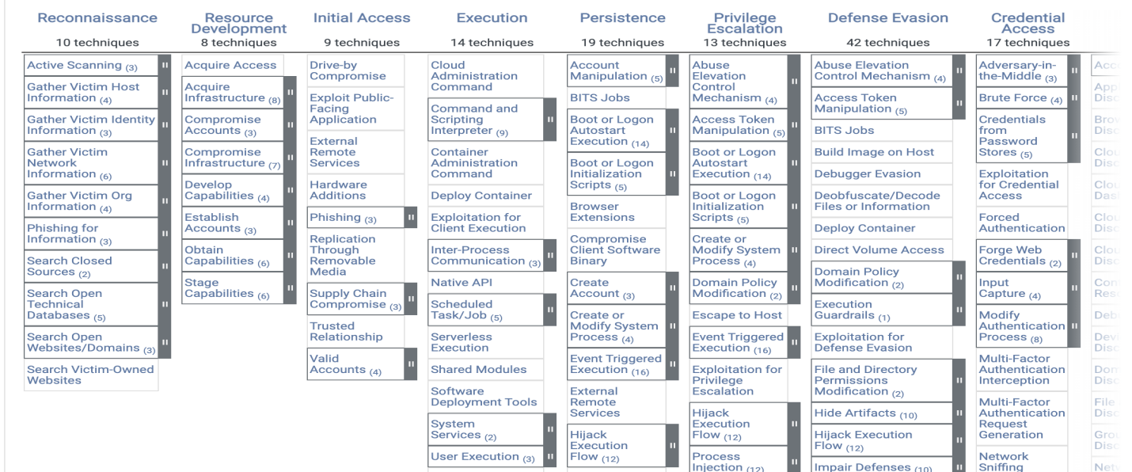
1. MITRE ATT&CK

Slide 11
1. MITRE ATT&CK
You can find the full list (which is way bigger than the screenshot) on
this link
Spend some time exploring it !
You can filter on the left by some categories, like OSes

Slide 12
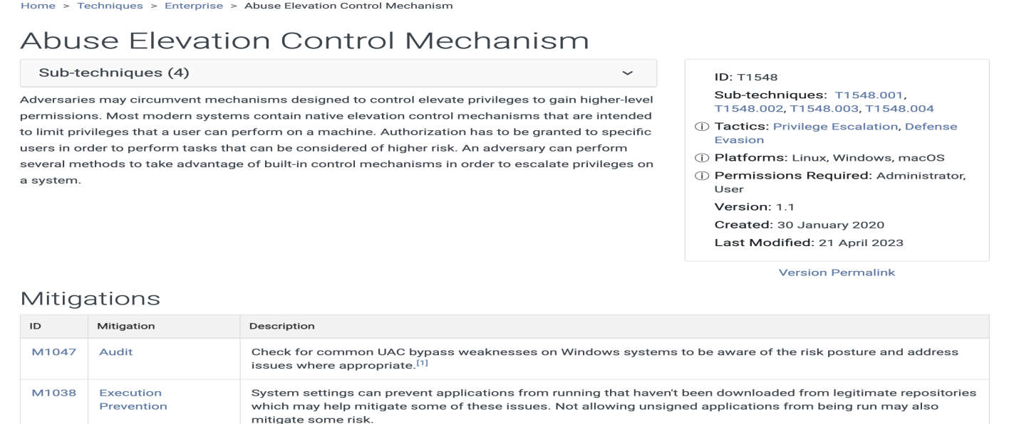
1. MITRE ATT&CK

Slide 13
1. MITRE ATT&CK
On each category, you will find multiple information
a definition of the technique with the impact
information about the tactics, like ID, added date, version ...
a list of possible ways to mitigate this security issue
how to detect it
references

Slide 14
1. MITRE ATT&CK
This framework is really useful for all teams working on security !
This allows you to keep up with solutions and ways to detect
something unusual in your system by providing insight on the most
well-known attacks on multiple types of companies.
If we dig deeper, and some core concepts that you need to know about it

Slide 15
1. MITRE ATT&CK
MITRE ATT&CK is a globally-accessible knowledge base of adversary tactics and techniques based on real-world observations of cyber attacks.
It's developed and maintained by MITRE, a not-for-profit organization that operates research and development centers sponsored by the federal government of the United States.
ATT&CK stands for Adversarial Tactics, Techniques, and Common Knowledge.

Slide 16
1. MITRE ATT&CK
Framework for Cyber Threats: MITRE ATT&CK provides a comprehensive and detailed framework that describes the tactics, techniques, and procedures (TTPs) used by cyber adversaries. It's used to understand and categorize attack behaviors and strategies.
Tactics and Techniques: The framework is structured around two key concepts: tactics and techniques. Tactics represent the objectives or goals of the adversary (e.g., initial access, execution, persistence), while techniques represent the methods they use to achieve these objectives.

Slide 17
1. MITRE ATT&CK
Real-World Observations: The information in ATT&CK is derived from real-world observations of cyber attacks. This makes it a practical and valuable resource for understanding how adversaries operate in realistic scenarios.
Use Cases: MITRE ATT&CK is used for various cybersecurity purposes, including threat intelligence, defensive measures, security training, and red teaming. It helps in improving threat detection and response by providing a common language and understanding of adversary methods.

Slide 18
1. MITRE ATT&CK
Matrix for Enterprise, Mobile, and Cloud: The ATT&CK framework is divided into matrices for different environments: Enterprise (covering Windows, macOS, and Linux), Mobile, and Cloud. This ensures comprehensive coverage across different platforms and technologies.
Community-Driven: The framework is continuously updated with contributions from cybersecurity professionals and organizations worldwide. This community-driven approach keeps it relevant and up-to-date with the evolving cyber threat landscape.

Slide 19
1. MITRE ATT&CK
Training and Education: ATT&CK is also used as a training and education resource, helping to inform cybersecurity professionals about the latest adversary behaviors and enhance their ability to prepare and respond to cyber threats.
Open and Accessible: The framework is freely available and accessible, making it a widely used resource in the cybersecurity community for both private and public sector organizations.

Slide 20
1. MITRE ATT&CK
MITRE ATT&CK has become a foundational element in cybersecurity, offering a structured and comprehensive approach to understanding and combating cyber threats.
It's integral for cybersecurity professionals in threat modeling, security analysis, and in developing effective defense strategies.

Slide 21

Exercises

Slide 22
2. OWASP

Slide 23
2. OWASP
“
The Open Worldwide Application Security Project (OWASP) is an
online community that produces freely-available articles,
methodologies, documentation, tools, and technologies in the
field of web application security.
“

Slide 24
2. OWASP
OWASP is a well known group of volunteers that provides
publications around security, detection and mitigation.
We won't see here all the resources but only the main one !

Slide 25
2. OWASP
OWASP Software Assurance Maturity Model:
provide an effective and measurable way for all types of organizations to analyze and improve their software security posture
core objective is to raise awareness and educate organizations on how to design, develop, and deploy secure software

Slide 26
2. OWASP
OWASP Development Guide:
provides practical guidance and includes J2EE, ASP.NET, and PHP code samples.
covers an extensive array of application-level security issues, from SQL injection to phishing and credit card handling

Slide 27
2. OWASP
OWASP Testing Guide:
includes a "best practice" penetration testing framework that users can implement in their own organizations
provides a "low level" penetration testing guide that describes techniques for testing most common web application and web service security issues.

Slide 28
2. OWASP
OWASP Top 10 Incident Response Guidance:
provides a proactive approach to Incident Response planning
Webgoat:
a deliberately insecure web application created by OWASP as a
guide for secure programming practices.

Slide 29
2. OWASP
As you can see, the OWASP provides a lot of resources and material
around security, for a large audience !
From engineer to manager and business owners, there are
explanations and documents about security accessible to all.

Slide 30
2. OWASP
In the next chapter we will focus on the most known publication of
the OWASP, the OWASP Top Ten.
This Top 10 references since 2003 - and is updated regularly - the
principal security issues.
The publication is well known and used as reference by other groups
like MITRE, but also states funded organization like the FTC (Federal
Trade Commission - USA) or the ANSSI (Autorité Nationale en matière
de Sécurité et de défense des Systèmes d'Information - France)

Slide 31
Exercises

